Slide 1

Bottom-up Parsing
Dewan Tanvir Ahmed
Lecturer, CSE
BUET

Slide 2
Parsing Techniques
Top-down parsers (LL(1), recursive descent)
Start at the root of the parse tree from the start symbol and grow toward leaves (similar to a derivation)
Pick a production and try to match the input
Bad “pick” ⇒ may need to backtrack
Some grammars are backtrack-free (predictive parsing)
Bottom-up parsers (LR(1), operator precedence)
Start at the leaves and grow toward root
We can think of the process as reducing the input string to the start symbol
At each reduction step a particular substring matching the right-side of a production is replaced by the symbol on the left-side of the production
Bottom-up parsers handle a large class of grammars

Slide 3
Top-down Parsing
S
fringe of the
parse tree
A
B
start symbol
?
D
C
S
left-to-right
scan
?
left-most
derivation
lookahead
Bottom-up Parsing
input string
S
lookahead
upper fringe of
the parse tree
?
A
D
C
right-most
derivation
in reverse
lookahead

Slide 4
Bottom-up Parsing
A general style of bottom-up syntax analysis, known as shift-reduce parsing.
    Two types of bottom-up parsing:
      Operator-Precedence parsing
      LR parsing

Slide 5
Bottom Up Parsing
“Shift-Reduce” Parsing
Reduce a string to the start symbol of the grammar.
At every step a particular sub-string is matched (in left-to-right fashion) to the right side of some production and then it is substituted by the non-terminal in the left hand side of the production.
abbcde
aAbcde
aAde
aABe
S
Reverse order
Consider:
S → aABe
A → Abc | b
B → d
Rightmost Derivation:
S ⇒ aABe ⇒ aAde ⇒ aAbcde ⇒ abbcde

Slide 6
Handles
Handle of a string: Substring that matches the RHS of some production AND whose reduction to the non-terminal on the LHS is a step along the reverse of some rightmost derivation.
Formally:
  handle of a right sentential form γ is <A → β, location of β in γ> , that satisfies the above property.
  i.e. A → β is a handle of αβγ at the location immediately after the end of α, if:
  S => αAγ => αβγ
A certain sentential form may have many different handles.
Right sentential forms of a non-ambiguous grammar
have one unique handle
*
rm
rm

Slide 7
Example
Consider:
S → aABe
A → Abc | b
B → d
S ⇒ aABe ⇒ aAde ⇒ aAbcde ⇒ abbcde
It follows that:
S → aABe is a handle of aABe in location 1.
B → d is a handle of aAde in location 3.
A → Abc is a handle of aAbcde in location 2.
A → b is a handle of abbcde in location 2.

Slide 8
Handle Pruning
A rightmost derivation in reverse can be obtained by “handle-pruning.”
Apply this to the previous example.
S → aABe
A → Abc | b
B → d
abbcde
Find the handle = b at loc. 2
aAbcde
b at loc. 3 is not a handle:
aAAcde
... blocked.
Also Consider:
E → E + E | E * E |
| ( E ) | id
Derive id+id*id
By two different Rightmost
derivations

Slide 9
Handle-pruning, Bottom-up Parsers
The process of discovering a handle & reducing it to the
appropriate left-hand side is called handle pruning.
Handle pruning forms the basis for a bottom-up parsing method.
To construct a rightmost derivation
  S = γ₀ ⇒ γ₁ ⇒ γ₂ ⇒ … ⇒ γ_{n-1} ⇒ γ_{n} = w
Apply the following simple algorithm
  for i ← n to 1 by -1
  Find the handle A_{i} →β_{i} in γ_{i}
  Replace β_{i} with A_{i} to generate γ_{i-1}

Slide 10
Handle Pruning, II
Consider the cut of a parse-tree of a certain right sentential form.
S
A
Left part Handle (only terminals here)
Viable prefix

Slide 11
Example
Sentential Form Handle
Prod’n , Pos’n
S —
Expr 1,1
Expr – Term 3,3
Expr – Term * Factor 5,5
Expr – Term * <id,y> 9,5
Expr – Factor * <id,y> 7,3
Expr – <num,2> * <id,y> 8,3
Term – <num,2> * <id,y> 4,1
Factor – <num,2> * <id,y> 7,1
<id,x> – <num,2> * <id,y> 9,1
1 S → Expr
2 Expr → Expr + Term
3 | Expr – Term
4 | Term
5 Term → Term * Factor
6 | Term / Factor
7 | Factor
8 Factor → num
9 | id
The expression grammar
Handles for rightmost derivation of input string:
x – 2 * y

Slide 12
Shift Reduce Parsing with a Stack
Two problems:
  locate a handle and
  decide which production to use (if there are more than two candidate productions).
General Construction: using a stack:
  “shift” input symbols into the stack until a handle is found on top of it.
  “reduce” the handle to the corresponding non-terminal.
  other operations:
    “accept” when the input is consumed and only the start symbol is on the stack, also: “error”

Slide 13
Example
STACK
INPUT
Remark
E → E + E
| E * E
| ( E ) | id
$
$ id
$E
id + id * id$
+ id * id$
+ id * id$
Shift
Reduce by E → id

Slide 14
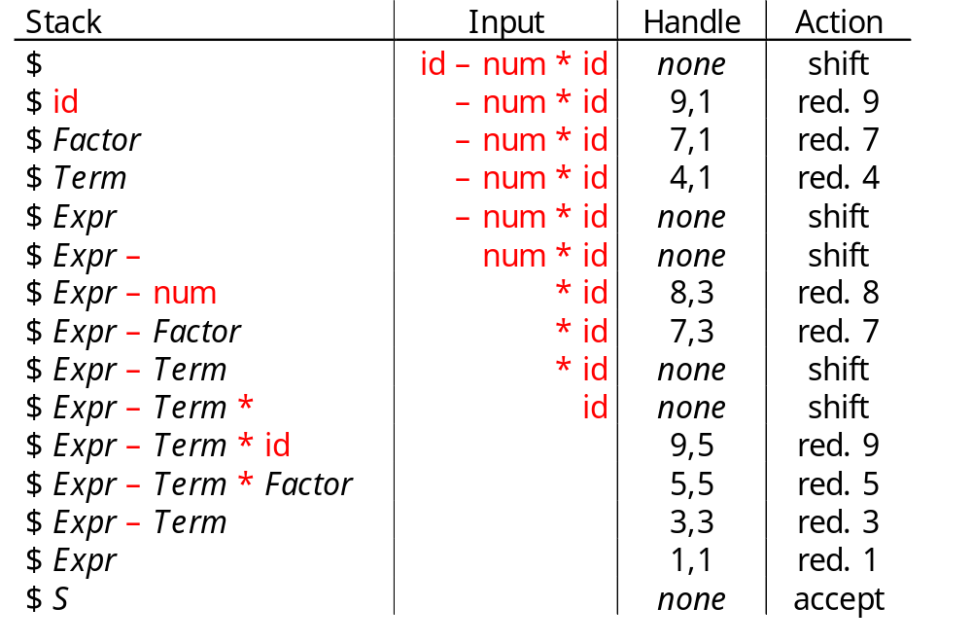
Example, Corresponding Parse Tree
S
Expr
Expr
–
Term
Term
Term
*
Fact.
Fact.
Fact.
<id,y>
<id,x>
<num,2>
5 shifts +
9 reduces +
1 accept
1. Shift until top-of-stack is the right end of a handle
2. Pop the right end of the handle & reduce

Slide 15
Shift-reduce Parsing
Shift reduce parsers are easily built and easily understood
A shift-reduce parser has just four actions
Shift — next word is shifted onto the stack
Reduce — right end of handle is at top of stack
  Locate left end of handle within the stack
  Pop handle off stack & push appropriate lhs
Accept — stop parsing & report success
Error — call an error reporting/recovery routine
Accept & Error are simple
Shift is just a push and a call to the scanner
Reduce takes |rhs| pops & 1 push
If handle-finding requires state, put it in the stack
Handle finding is key
handle is on stack
finite set of handles
use a DFA !

Slide 16
More on Shift-Reduce Parsing
Viable prefixes:
  The set of prefixes of a right sentential form that can appear on the stack of a Shift-Reduce parser is called Viable prefixes.
Conflicts
“shift/reduce” or “reduce/reduce”
Example:
stmt → if expr then stmt
| if expr then stmt else stmt
| other (any other statement)
We can’t tell whether it is a handle
Stack Input
if … then stmt else …
Shift/ Reduce Conflict

Slide 17
More Conflicts
stmt → id ( parameter-list )
stmt → expr := expr
parameter-list → parameter-list , parameter | parameter
parameter → id
expr-list → expr-list , expr | expr
expr → id | id ( expr-list )
  Consider the string A(I,J)
  Corresponding token stream is id(id, id)
  After three shifts:
  Stack = … id(id Input = , id)…
  Reduce/Reduce Conflict … what to do?
  (it really depends on what is A,
  an array? or a procedure?
How the symbol third from the top of stack determines the reduction to be made, even though it is not involved in the reduction. Shift-reduce parsing can utilize information far down in the stack to guide the parse

Slide 18
Operator-Precedence Parser
Operator grammar
  small, but an important class of grammars
  we may have an efficient operator precedence parser (a shift-reduce parser) for an operator grammar.
In an operator grammar, no production rule can have:
  ε at the right side
  two adjacent non-terminals at the right side.
Ex:
E→AB E→EOE E→E+E |
A→a E→id E*E |
B→b O→+|*|/ E/E | id
not operator grammar not operator grammar operator grammar

Slide 19
Precedence Relations
In operator-precedence parsing, we define three disjoint precedence relations between certain pairs of terminals.
a <. b b has higher precedence than a
a =· b b has same precedence as a
a .> b b has lower precedence than a
The determination of correct precedence relations between terminals are based on the traditional notions of associativity and precedence of operators. (Unary minus causes a problem).

Slide 20
Using Operator-Precedence Relations
The intention of the precedence relations is to find the handle of a right-sentential form,
<. with marking the left end,
=· appearing in the interior of the handle, and
.> marking the right hand.
In our input string $a₁a₂...a_{n}$, we insert the precedence relation between the pairs of terminals (the precedence relation holds between the terminals in that pair).

Slide 21
Using Operator -Precedence Relations
E → E+E | E-E | E*E | E/E | E^E | (E) | -E | id
The partial operator-precedence
table for this grammar
Then the input string id+id*id with the precedence relations inserted will be:
$ <. id .> + <. id .> * <. id .> $
 | id | + | * | $
id |  | .> | .> | .>
+ | <. | .> | <. | .>
* | <. | .> | .> | .>
$ | <. | <. | <.

Slide 22
To Find The Handles
Scan the string from left end until the first .> is encountered.
Then scan backwards (to the left) over any =· until a <. is encountered.
The handle contains everything to left of the first .> and to the right of the <. is encountered.
$ <. id .> + <. id .> * <. id .> $ E → id $ id + id * id $
$ <. + <. id .> * <. id .> $ E → id $ E + id * id $
$ <. + <. * <. id .> $ E → id $ E + E * id $
$ <. + <. * .> $ E → E*E $ E + E * .E $
$ <. + .> $ E → E+E $ E + E $
$ $ $ E $

Slide 23
Operator-Precedence Parsing Algorithm
The input string is w$, the initial stack is $ and a table holds precedence relations between certain terminals
Algorithm:
set p to point to the first symbol of w$ ;
repeat forever
if ( $ is on top of the stack and p points to $ ) then return
else {
let a be the topmost terminal symbol on the stack and let b be the symbol pointed to by p;
if ( a <. b or a =· b ) then { /* SHIFT */
push b onto the stack;
advance p to the next input symbol;
}
else if ( a .> b ) then /* REDUCE */
repeat pop stack
until ( the top of stack terminal is related by <. to the terminal most recently popped );
else error();
}

Slide 24
Operator-Precedence Parsing Algorithm -- Example
stack input action
$ id+id*id$ $ <. id shift
$id +id*id$ id .> + reduce E → id
$ +id*id$ shift
$+ id*id$ shift
$+id *id$ id .> * reduce E → id
$+ *id$ shift
$+* id$ shift
$+*id $ id .> $ reduce E → id
$+* $ * .> $ reduce E → E*E
$+ $ + .> $ reduce E → E+E
$ $ accept
 | id | + | * | $
id |  | .> | .> | .>
+ | <. | .> | <. | .>
* | <. | .> | .> | .>
$ | <. | <. | <.

Slide 25
How to Create Operator-Precedence Relations
We use associativity and precedence relations among operators.
If operator θ₁ has higher precedence than operator θ ₂, ➔ θ ₁ .> θ ₂ and θ ₂ <. θ ₁
If operator θ ₁ and operator θ ₂ have equal precedence, they are left-associative ➔ θ ₁ .> θ ₂ and θ ₂ .> θ ₁ they are right-associative ➔ θ ₁ <. θ ₂ and θ ₂ <. θ ₁
For all operators θ, θ <. id, id .> θ, θ <. (, (<. θ, θ .> ), ) .> θ, θ .> $, and $ <. θ
Also, let
(=·) $ <. ( id .> ) ) .> $
( <. ( $ <. id id .> $ ) .> )
( <. id

Slide 26
Operator-Precedence Relations
 | + | - | * | / | ^ | id | ( | ) | $
+ | .> | .> | <. | <. | <. | <. | <. | .> | .>
- | .> | .> | <. | <. | <. | <. | <. | .> | .>
* | .> | .> | .> | .> | <. | <. | <. | .> | .>
/ | .> | .> | .> | .> | <. | <. | <. | .> | .>
^ | .> | .> | .> | .> | <. | <. | <. | .> | .>
id | .> | .> | .> | .> | .> |  |  | .> | .>
( | <. | <. | <. | <. | <. | <. | <. | =·
) | .> | .> | .> | .> | .> |  |  | .> | .>
$ | <. | <. | <. | <. | <. | <. | <.

Slide 27
Handling Unary Minus
Operator-Precedence parsing cannot handle the unary minus when we also have the binary minus in our grammar.
The best approach to solve this problem, let the lexical analyzer handle this problem.
  The lexical analyzer will return two different tokens for the unary minus and the binary minus.
  The lexical analyzer will need a lookhead to distinguish the binary minus from the unary minus.
Then, we make
θ <. unary-minus for any operator
unary-minus .> θ if unary-minus has higher precedence than θ
unary-minus <. θ if unary-minus has lower (or equal) precedence than θ

Slide 28
Precedence Functions
Compilers using operator precedence parsers do not need to store the table of precedence relations.
The table can be encoded by two precedence functions f and g that map terminal symbols to integers.
For symbols a and b.
f(a) < g(b) whenever a <. b
f(a) = g(b) whenever a =· b
f(a) > g(b) whenever a .> b
Algorithm 4.6 Constructing precedence functions

Slide 29
Constructing precedence functions
Method:
  Create symbols f_{a} and g_{b} for each a that is a terminal or $.
  Partition the created symbols into as many groups as possible, in such a way that if a =. b, then f_{a} and g_{b} are in the same group.
  Create a directed graph whose nodes are the groups found in (2). For any a and b, if a <.b , place an edge from the group of g_{b} to the group of f_{a}. Of a .> b, place an edge from the group of f_{a} to that of g_{b.}
  If the graph constructed in (3) has a cycle, then no precedence functions exist. If there are no cycle, let f(a) be the length of the longest path beginning at the group of f_{a}; let g(a) be the length of the longest path beginning at the group of g_{a.}

Slide 30
Example
 | + | * | Id | $
f | 2 | 4 | 4 | 0
g | 1 | 3 | 5 | 0
g_{id}
f_{id}
f*
g*
g₊
f₊
f$
g$

Slide 31
Disadvantages of Operator Precedence Parsing
Disadvantages:
  It cannot handle the unary minus (the lexical analyzer should handle the unary minus).
  Small class of grammars.
  Difficult to decide which language is recognized by the grammar.
Advantages:
  simple
  powerful enough for expressions in programming languages

Slide 32
Error Recovery in Operator-Precedence Parsing
Error Cases:
  No relation holds between the terminal on the top of stack and the next input symbol.
  A handle is found (reduction step), but there is no production with this handle as a right side
Error Recovery:
  Each empty entry is filled with a pointer to an error routine.
  Decides the popped handle “looks like” which right hand side. And tries to recover from that situation.

Slide 33
Handling Shift/Reduce Errors
When consulting the precedence matrix to decide whether to shift or reduce, we may find that no relation holds between the top stack and the first input symbol.
To recover, we must modify (insert/change)
  Stack or
  Input or
  Both.
  We must be careful that we don’t get into an infinite loop.

Slide 34
Example
 | id | ( | ) | $
id | e3 | e3 | .> | .>
( | <. | <. | =. | e4
) | e3 | e3 | .> | .>
$ | <. | <. | e2 | e1
e1: Called when : whole expression is missing
insert id onto the input
issue diagnostic: ‘missing operand’
e2: Called when : expression begins with a right parenthesis
delete ) from the input
issue diagnostic: ‘unbalanced right parenthesis’

Slide 35
Example
 | id | ( | ) | $
id | e3 | e3 | .> | .>
( | <. | <. | =. | e4
) | e3 | e3 | .> | .>
$ | <. | <. | e2 | e1
e3: Called when : id or ) is followed by id or (
insert + onto the input
issue diagnostic: ‘missing operator’
e4: Called when : expression ends with a left parenthesis
pop ( from the stack
issue diagnostic: ‘missing right parenthesis’

Slide 36
The End

